Slide 1


Git
Tutorial
A Distributed Version-Control System

Slide 2

- Chapter 2 -
Git Basics

Slide 3
- Git Basics -
Getting a Git Repository

Slide 4
Git Basics
Getting a Git Repository
There is 2 ways to obtain a Git repository :
    Turn a local directory to a Git repository.
    Clone an existing Git repository.
04

Slide 5
Git Basics
Getting a Git Repository - Initializing a Repository in an Existing Directory
1. Go to your project directory:
Linux:
MacOS:
Windows:
$ cd /home/user/my_project
$ cd /Users/user/my_project
$ cd C:/Users/user/my_project
05

Slide 6
Git Basics
Getting a Git Repository - Initializing a Repository in an Existing Directory
2. Make it a Git repository:
At this point, nothing in your project is tracked yet.
To start version-controlling existing files:
$ git init
$ git add *.c
$ git add LICENSE
$ git commit -m 'Initial project version'
06

Slide 7
Git Basics
Getting a Git Repository - Cloning an Existing Repository
To get a copy of an existing Git repository:
The command format is like this: git clone <url>
To clone it with another directory:
git clone <url> <new-directory>
$ git clone https://github.com/libgit2/libgit2
$ git clone https://github.com/libgit2/libgit2 mylibgit
07

Slide 8
Git Basics
Getting a Git Repository - Cloning an Existing Repository
Git’s transfer protocols:
HTTPS (the url is like this:)
SSH (the url is like this:)
To see pros and cons of each,
read “Getting Git on a Server” in page 111 of the Book.
https://github.com/...
git@github.com:...
08

Slide 9
- Git Basics -
Recording Changes to
the Repository

Slide 10
Git Basics
Recording Changes to the Repository
Each file in your working directory can be in one of two states:
Tracked
    Unmodified
    Modified
    Staged
Untracked
10

Slide 11
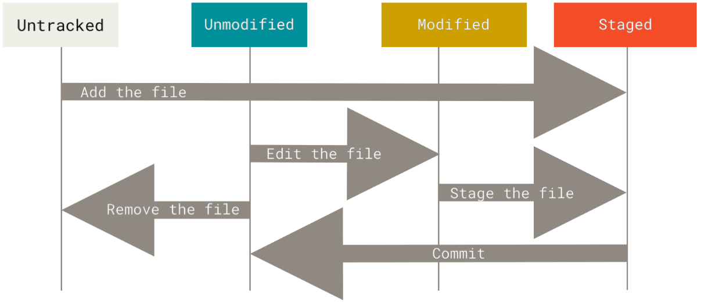
Git Basics
Recording Changes to the Repository
Figure 8. The lifecycle of the status of your files
11

Slide 12
Git Basics
Recording Changes to the Repository - Checking the Status of Your Files
Use git status to determine which files are in which state is the.
Right after a clone:
$ git status
On branch master
Your branch is up-to-date with 'origin/master'.
nothing to commit, working directory clean
12

Slide 13
Git Basics
Recording Changes to the Repository - Checking the Status of Your Files
Let’s add a new file to your project, a simple README file:
$ echo 'My Project' > README
$ git status
On branch master
Your branch is up-to-date with 'origin/master'.
Untracked files:
(use "git add <file>..." to include in what will be committed)
README
nothing added to commit but untracked files present
(use "git add" to track)
13

Slide 14
Git Basics
Recording Changes to the Repository - Tracking New Files
Use git add to begin tracking the README file:
Now check the status:
$ git add README
$ git status
On branch master
Your branch is up-to-date with 'origin/master'.
Changes to be committed:
(use "git restore --staged <file>..." to unstage)
new file: README
14

Slide 15
Git Basics
Recording Changes to the Repository - Tracking New Files
Some sort of tracking files:
Considering this form: git add <files>
Use a path to add a file from subdirectories:
Add multiple file at once (you also can add multiple path):
$ git add code/v2/file.py
$ git add file_1.py file_2.py file_3.py
15

Slide 16
Git Basics
Recording Changes to the Repository - Staging Modified Files
Let’s change a file that was already tracked:
$ echo 'My Project' > README
$ git status
On branch master
Your branch is up-to-date with 'origin/master'.
Changes to be committed:
(use "git reset HEAD <file>..." to unstage)
new file: README
Changes not staged for commit:
(use "git add <file>..." to update what will be committed)
(use "git checkout -- <file>..." to discard changes in working directory)
modified: CONTRIBUTING.md
16

Slide 17
Git Basics
Recording Changes to the Repository - Staging Modified Files
git add is a multipurpose command. Now we use it to stage a file:
$ git add CONTRIBUTING.md
$ git status
On branch master
Your branch is up-to-date with 'origin/master'.
Changes to be committed:
(use "git reset HEAD <file>..." to unstage)
new file: README
modified: CONTRIBUTING.md
17

Slide 18
Git Basics
Recording Changes to the Repository - Staging Modified Files
Suppose you remember one little change that you want to make in CONTRIBUTING.md before you commit it.
So lets change the CONTRIBUTING.md:
$ vim CONTRIBUTING.md
18

Slide 19
Git Basics
Recording Changes to the Repository - Staging Modified Files
Then run git status one more time:
$ git status
On branch master
Your branch is up-to-date with 'origin/master'.
Changes to be committed:
(use "git reset HEAD <file>..." to unstage)
new file: README
modified: CONTRIBUTING.md
Changes not staged for commit:
(use "git add <file>..." to update what will be committed)
(use "git checkout -- <file>..." to discard changes in working directory)
modified: CONTRIBUTING.md
19

Slide 20
Git Basics
Recording Changes to the Repository - Staging Modified Files
What happend?
The CONTRIBUTING.md is listed as both staged and unstaged.
So if you modify a file after you run git add,
you have to run git add again to stage the latest version of the file:
20

Slide 21
Git Basics
Recording Changes to the Repository - Short Status
To get a simplified status, use one of the following:
git status -s
git status --short
$ git status -s
M README
MM Rakefile
A lib/git.rb
M lib/simplegit.rb
?? LICENSE.txt
Modified
Was modified, staged and then modified again
New staged file
Modified and staged
New untracked file
21

Slide 22
Git Basics
Recording Changes to the Repository - Ignoring Files
If you have a class of files that you want Git to ignore them,
create a .gitignore file and add the patterns to it:
First line: ignore any files ending in “.o” or “.a”.
Second line: ignore all files whose names end with a tilde (~).
The rules of these patterns are given on page 31 of the book.
$ cat .gitignore
*.[oa]
*~
22

Slide 23
Git Basics
Recording Changes to the Repository - Ignoring Files
Here is another example .gitignore file:
# ignore all .a files
*.a
# but do track lib.a, even though you're ignoring .a files above
!lib.a
# only ignore the TODO file in the current directory, not subdir/TODO
/TODO
# ignore all files in any directory named build
Build/
# ignore doc/notes.txt, but not doc/server/arch.txt
doc/*.txt
# ignore all .pdf files in the doc/ directory and any of its subdirectories
doc/**/*.pdf
23

Slide 24
Git Basics
Recording Changes to the Repository - Viewing Your Staged and Unstaged Changes
If you want to know exactly what you changed, not just which files were changed. You’ll probably use it most often to answer these two questions:
What have you changed but not yet staged?
What have you staged that you are about to commit?
Assume that we edit and stage README file and then edit the CONTRIBUTING.md file without staging it.
24

Slide 25
Git Basics
Recording Changes to the Repository - Viewing Your Staged and Unstaged Changes
So git status shows this:
$ git status
On branch master
Your branch is up-to-date with 'origin/master'.
Changes to be committed:
(use "git reset HEAD <file>..." to unstage)
new file: README
Changes not staged for commit:
(use "git add <file>..." to update what will be committed)
(use "git checkout -- <file>..." to discard changes in working directory)
modified: CONTRIBUTING.md
25

Slide 26
Git Basics
Recording Changes to the Repository - Viewing Your Staged and Unstaged Changes
To see what you’ve changed but not yet staged:
$ git diff
diff --git a/CONTRIBUTING.md b/CONTRIBUTING.md
index 8ebb991..643e24f 100644
--- a/CONTRIBUTING.md
+++ b/CONTRIBUTING.md
@@ -65,7 +65,8 @@ branch directly, things can get messy.
Please include a nice description of your changes when you submit your PR;
if we have to read the whole diff to figure out why you're contributing
in the first place, you're less likely to get feedback and have your change
-merged in.
+merged in. Also, split your changes into comprehensive chunks if your patch is
+longer than a dozen lines.
If you are starting to work on a particular area, feel free to submit a PR
that highlights your work in progress (and note in the PR title that it's
25

Slide 27
Git Basics
Recording Changes to the Repository - Viewing Your Staged and Unstaged Changes
To see what you’ve staged that will go into your next commit,
$ git diff –staged
diff --git a/README b/README
new file mode 100644
index 0000000..03902a1
--- /dev/null
+++ b/README
@@ -0,0 +1 @@
+My Project
27

Slide 28
Git Basics
Recording Changes to the Repository - Viewing Your Staged and Unstaged Changes
For another example, if you stage the CONTRIBUTING.md file and then edit it, you can use git diff tosee the changes in the file that are staged and the changes that are unstaged.
$ git add CONTRIBUTING.md
$ echo '# test line' >> CONTRIBUTING.md
28

Slide 29
Git Basics
Recording Changes to the Repository - Viewing Your Staged and Unstaged Changes
If our environment looks like this:
$ git status
On branch master
Your branch is up-to-date with 'origin/master'.
Changes to be committed:
(use "git reset HEAD <file>..." to unstage)
modified: CONTRIBUTING.md
Changes not staged for commit:
(use "git add <file>..." to update what will be committed)
(use "git checkout -- <file>..." to discard changes in working directory)
modified: CONTRIBUTING.md
29

Slide 30
Git Basics
Recording Changes to the Repository - Viewing Your Staged and Unstaged Changes
Now you can use git diff to see what is still unstaged
$ git diff
diff --git a/CONTRIBUTING.md b/CONTRIBUTING.md
index 643e24f..87f08c8 100644
--- a/CONTRIBUTING.md
+++ b/CONTRIBUTING.md
@@ -119,3 +119,4 @@ at the
## Starter Projects
See our [projects
list](https://github.com/libgit2/libgit2/blob/development/PROJECTS.md).
+# test line
30

Slide 31
Git Basics
Recording Changes to the Repository - Viewing Your Staged and Unstaged Changes
And git diff –cached to see what you’ve staged so far
(--staged and --cached are synonyms):
31

Slide 32
Git Basics
Recording Changes to the Repository - Viewing Your Staged and Unstaged Changes
$ git diff --cached
diff --git a/CONTRIBUTING.md b/CONTRIBUTING.md
index 8ebb991..643e24f 100644
--- a/CONTRIBUTING.md
+++ b/CONTRIBUTING.md
@@ -65,7 +65,8 @@ branch directly, things can get messy.
Please include a nice description of your changes when you submit your PR;
if we have to read the whole diff to figure out why you're contributing
in the first place, you're less likely to get feedback and have your change
-merged in.
+merged in. Also, split your changes into comprehensive chunks if your patch is
+longer than a dozen lines.
If you are starting to work on a particular area, feel free to submit a PR
that highlights your work in progress (and note in the PR title that it's
32

Slide 33
Git Basics
Recording Changes to the Repository - Committing Your Changes
To commir all files in the staging area:
Doing so launches your editor of choice.
$ git commit
33

Slide 34
Git Basics
Recording Changes to the Repository - Committing Your Changes
The editor displays the following text (this example is a Vim screen):
# Please enter the commit message for your changes. Lines starting
# with '#' will be ignored, and an empty message aborts the commit.
# On branch master
# Your branch is up-to-date with 'origin/master'.
#
# Changes to be committed:
# new file: README
# modified: CONTRIBUTING.md
#
~
~
~
".git/COMMIT_EDITMSG" 9L, 283C
34

Slide 35
Git Basics
Recording Changes to the Repository - Committing Your Changes
You can type your commit message inline with a -m flag:
This detail tells you:
Which branch you committed to (master)
What SHA-1 checksum the commit has (463dc4f)
How many files were changed
Statistics about lines added and removed
$ git commit -m "Story 182: fix benchmarks for speed"
[master 463dc4f] Story 182: fix benchmarks for speed
2 files changed, 2 insertions(+)
create mode 100644 README
35

Slide 36
Git Basics
Recording Changes to the Repository - Skipping the Staging Area
You can skip the staging area with adding the -a option:
$ git commit -a -m 'Add new benchmarks'
[master 83e38c7] Add new benchmarks
1 file changed, 5 insertions(+), 0 deletions(-)
36

Slide 37
Git Basics
Recording Changes to the Repository - Removing Files
If you simply remove the file from your working directory:
$ rm PROJECTS.md
$ git status
On branch master
Your branch is up-to-date with 'origin/master'.
Changes not staged for commit:
(use "git add/rm <file>..." to update what will be committed)
(use "git checkout -- <file>..." to discard changes in working directory)
deleted: PROJECTS.md
no changes added to commit (use "git add" and/or "git commit -a")
37

Slide 38
Git Basics
Recording Changes to the Repository - Removing Files
Then, if you run git rm, it stages the file’s removal:
The next time you commit, the file will be gone and no longer tracked.
$ rm PROJECTS.md
$ git status
On branch master
Your branch is up-to-date with 'origin/master'.
Changes to be committed:
(use "git reset HEAD <file>..." to unstage)
deleted: PROJECTS.md
(In case that you forgot to add something to .gitignore)
38

Slide 39
Git Basics
Recording Changes to the Repository - Removing Files
To keep the file on your hard drive but not have Git track it anymore
(In case that you forgot to add something to .gitignore):
You can pass files, directories, and file-glob patterns to the git rm:
This removes all files that have the .log extension in the log/ directory:
This command removes all files whoe names end with a ~:
$ git rm --cached README
$ git rm log/\*.log
$ git rm \*~
39

Slide 40
Git Basics
Recording Changes to the Repository - Moving Files
To rename a file in Git (short way):
$ git mv README.md README
$ git status
On branch master
Your branch is up-to-date with 'origin/master'.
Changes to be committed:
(use "git reset HEAD <file>..." to unstage)
renamed: README.md -> README
40

Slide 41
Git Basics
Recording Changes to the Repository - Moving Files
Long way:
$ mv README.md README
$ git rm README.md
$ git add README
41

Slide 42
- Git Basics -
Viewing the Commit History

Slide 43
Git Basics
Viewing the Commit History
The most basic and powerfultool to do this is the git log:
To use it, let’s clone a simple project:
Now let’s look at git log command:
$ git clone https://github.com/schacon/simplegit-progit
43

Slide 44
Git Basics
Viewing the Commit History
$ git log
commit ca82a6dff817ec66f44342007202690a93763949
Author: Scott Chacon <schacon@gee-mail.com>
Date: Mon Mar 17 21:52:11 2008 -0700
Change version number
commit 085bb3bcb608e1e8451d4b2432f8ecbe6306e7e7
Author: Scott Chacon <schacon@gee-mail.com>
Date: Sat Mar 15 16:40:33 2008 -0700
Remove unnecessary test
The most recent commits show up first.
44

Slide 45
Git Basics
Viewing the Commit History
Some usefull options:
-p or –patch: Shows the difference.
-2: Shows only the last two commit.
45

Slide 46
Git Basics
Viewing the Commit History
$ git log -p -1
commit ca82a6dff817ec66f44342007202690a93763949
Author: Scott Chacon <schacon@gee-mail.com>
Date: Mon Mar 17 21:52:11 2008 -0700
Change version number
diff --git a/Rakefile b/Rakefile
index a874b73..8f94139 100644
--- a/Rakefile
+++ b/Rakefile
@@ -5,7 +5,7 @@ require 'rake/gempackagetask'
spec = Gem::Specification.new do |s|
s.platform = Gem::Platform::RUBY
s.name = "simplegit"
- s.version = "0.1.0"
+ s.version = "0.1.1"
s.author = "Scott Chacon"
s.email = "schacon@gee-mail.com"
s.summary = "A simple gem for using Git in Ruby code."
46

Slide 47
Git Basics
Viewing the Commit History
To see some abbreviated stats for each commit:
$ git log --stat
commit ca82a6dff817ec66f44342007202690a93763949
Author: Scott Chacon <schacon@gee-mail.com>
Date: Mon Mar 17 21:52:11 2008 -0700
Change version number
Rakefile | 2 +-
1 file changed, 1 insertion(+), 1 deletion(-)
47

Slide 48
Git Basics
Viewing the Commit History
Another example:
$ git log --stat
commit a11bef06a3f659402fe7563abf99ad00de2209e6
Author: Scott Chacon <schacon@gee-mail.com>
Date: Sat Mar 15 10:31:28 2008 -0700
Initial commit
README | 6 ++++++
Rakefile | 23 +++++++++++++++++++++++
lib/simplegit.rb | 25 +++++++++++++++++++++++++
3 files changed, 54 insertions(+)
48

Slide 49
Git Basics
Viewing the Commit History
Another really useful option is --pretty.
This option has some value:
oneline
short
full
fuller
$ git log –pretty=oneline
ca82a6dff817ec66f44342007202690a93763949 Change version number
085bb3bcb608e1e8451d4b2432f8ecbe6306e7e7 Remove unnecessary test
a11bef06a3f659402fe7563abf99ad00de2209e6 Initial commit
49

Slide 50
Git Basics
Viewing the Commit History
The most interesting option value is format, which allows you to specify your own log output format.
$ git log --pretty=format:"%h - %an, %ar : %s"
ca82a6d - Scott Chacon, 6 years ago : Change version number
085bb3b - Scott Chacon, 6 years ago : Remove unnecessary test
a11bef0 - Scott Chacon, 6 years ago : Initial commit
50

Slide 51
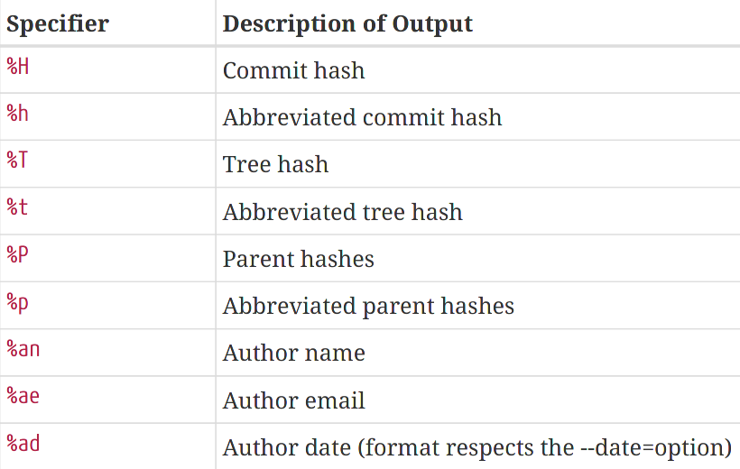
Git Basics
Viewing the Commit History
Some useful specifiers (to see more, go to page 43 of the book):
Table 1. Useful specifiers for git log --pretty=format
51

Slide 52
Git Basics
Viewing the Commit History
To add a nice little ASCII graph showing your branch and merge history:
$ git log --pretty=format:"%h %s" --graph
* 2d3acf9 Ignore errors from SIGCHLD on trap
* 5e3ee11 Merge branch 'master' of git://github.com/dustin/grit
|\
| * 420eac9 Add method for getting the current branch
* | 30e367c Timeout code and tests
* | 5a09431 Add timeout protection to grit
* | e1193f8 Support for heads with slashes in them
|/
* d6016bc Require time for xmlschema
* 11d191e Merge branch 'defunkt' into local
52

Slide 53
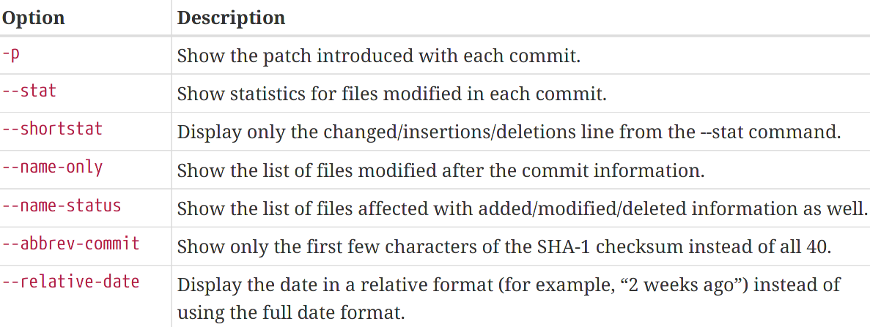
Git Basics
Viewing the Commit History
Some common otions (to see more, go to page 44 of the book):
Table 2. Common options to git log
53

Slide 54
Git Basics
Viewing the Commit History - Limiting Log Output
You can use option -<n>, where n is any integer to show the last n commits:
$ git log -2
commit ca82a6dff817ec66f44342007202690a93763949
Author: Scott Chacon <schacon@gee-mail.com>
Date: Mon Mar 17 21:52:11 2008 -0700
Change version number
commit 085bb3bcb608e1e8451d4b2432f8ecbe6306e7e7
Author: Scott Chacon <schacon@gee-mail.com>
Date: Sat Mar 15 16:40:33 2008 -0700
Remove unnecessary test
54

Slide 55
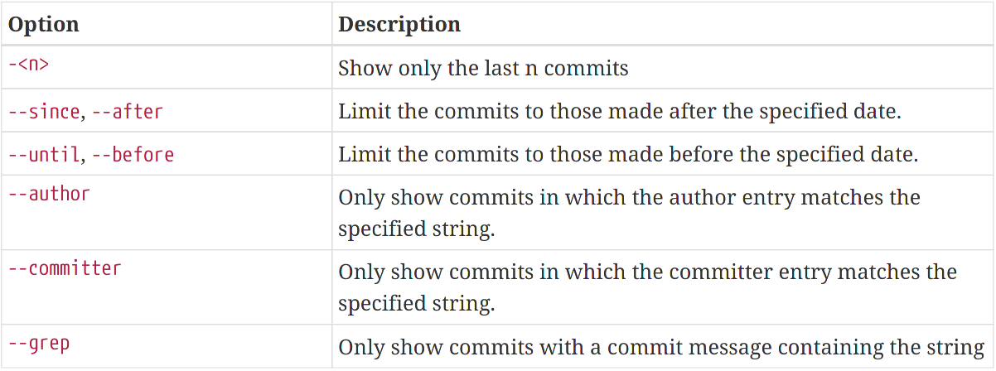
Git Basics
Viewing the Commit History - Limiting Log Output
Some usefull options:
Table 3. Options to limit the output of git log
55

Slide 56
Git Basics
Viewing the Commit History - Limiting Log Output
Examples:
$ git log --since=2.weeks
$ git log --since="2 years 1 day 3 minutes ago"
$ git log -S function_name
$ git log -- path/to/file
$ git log --grep="translation to persian"
56

Slide 57
Git Basics
Viewing the Commit History - Limiting Log Output
You can combine options:
command
$ git log --pretty="%h - %s" --author='Junio C Hamano'
--since="2008-10-01 --before="2008-11-01" --no-merges – t
5610e3b - Fix testcase failure when extended attributes are in use
acd3b9e - Enhance hold_lock_file_for_{update,append}() API
51a94af - Fix "checkout --track -b newbranch" on detached HEAD
output
57

Slide 58
- Git Basics -
Undoing Things

Slide 59
Git Basics
Undoing Things
Be careful, because you can’t always undo some of these undos!
If you want to redo that commit, make the additional changes you forgot, stage them, and commit again:
$ git commit -m 'Initial commit'
$ git add forgotten_file
$ git commit --amend
59

Slide 60
Git Basics
Undoing Things
You can use –amend to change the commit message:
This command opens your editor, replace the old commit with a new commit message and save changes.
$ git commit -m 'old commit'
$ git commit --amend
60

Slide 61
Git Basics
Undoing Things - Unstaging a Staged File
Assume that you staged two file and want to unstage one of them:
git reset HEAD <file1> ...
$ git status
On branch master
Changes to be committed:
(use "git reset HEAD <file>..." to unstage)
renamed: README.md -> README
modified: CONTRIBUTING.md
61

Slide 62
Git Basics
Undoing Things - Unstaging a Staged File
Here, we unstage the CONTRIBUTING.md:
$ git reset HEAD CONTRIBUTING.md
Unstaged changes after reset:
M CONTRIBUTING.md
$ git status
On branch master
Changes to be committed:
(use "git reset HEAD <file>..." to unstage)
renamed: README.md -> README
Changes not staged for commit:
(use "git add <file>..." to update what will be committed)
(use "git checkout -- <file>..." to discard changes in working directory)
modified: CONTRIBUTING.md
62

Slide 63
Git Basics
Undoing Things - Unmodifying a Modified File
If you realize that you don’t want to keep your changes, unmodify that file.
We had this sitaution:
$ git status
...
Changes not staged for commit:
(use "git add <file>..." to update what will be committed)
(use "git checkout -- <file>..." to discard changes in working directory)
modified: CONTRIBUTING.md
63

Slide 64
Git Basics
Undoing Things - Unmodifying a Modified File
And you can see that the changes have been reverted.
$ git checkout -- CONTRIBUTING.md
$ git status
On branch master
Changes to be committed:
(use "git reset HEAD <file>..." to unstage)
renamed: README.md -> README
64

Slide 65
Git Basics
Undoing Things - Unstaging a Staged File with git restore
Assume that you staged two file and want to unstage one of them:
git restore HEAD <file1> ...
$ git status
On branch master
Changes to be committed:
(use "git reset HEAD <file>..." to unstage)
renamed: README.md -> README
modified: CONTRIBUTING.md
65

Slide 66
Git Basics
Undoing Things - Unstaging a Staged File
Here, we unstage the CONTRIBUTING.md:
$ git restore --staged CONTRIBUTING.md
$ git status
On branch master
Changes to be committed:
(use "git restore --staged <file>..." to unstage)
renamed: README.md -> README
Changes not staged for commit:
(use "git add <file>..." to update what will be committed)
(use "git restore <file>..." to discard changes in working directory)
modified: CONTRIBUTING.md
66

Slide 67
Git Basics
Undoing Things - Unmodifying a Modified File with git restore
If you realize that you don’t want to keep your changes, unmodify that file.
We had this sitaution:
$ git status
...
Changes not staged for commit:
(use "git add <file>..." to update what will be committed)
(use "git checkout -- <file>..." to discard changes in working directory)
modified: CONTRIBUTING.md
67

Slide 68
Git Basics
Undoing Things - Unmodifying a Modified File with git restore
And you can see that the changes have been reverted.
$ git restore CONTRIBUTING.md
$ git status
On branch master
Changes to be committed:
(use "git restore --staged <file>..." to unstage)
renamed: README.md -> README
68

Slide 69



Mohammad A. S. Minabi
bigm00bnd@gmail.com
Group
Members
Mohammad H. Bahrampour
bahrampour@pm.me
Hamid R. K. Pishghadam
kaveh@riseup.net

